Slide 1

The Ramen Shop Website Development Report
Alex Legner

Slide 2
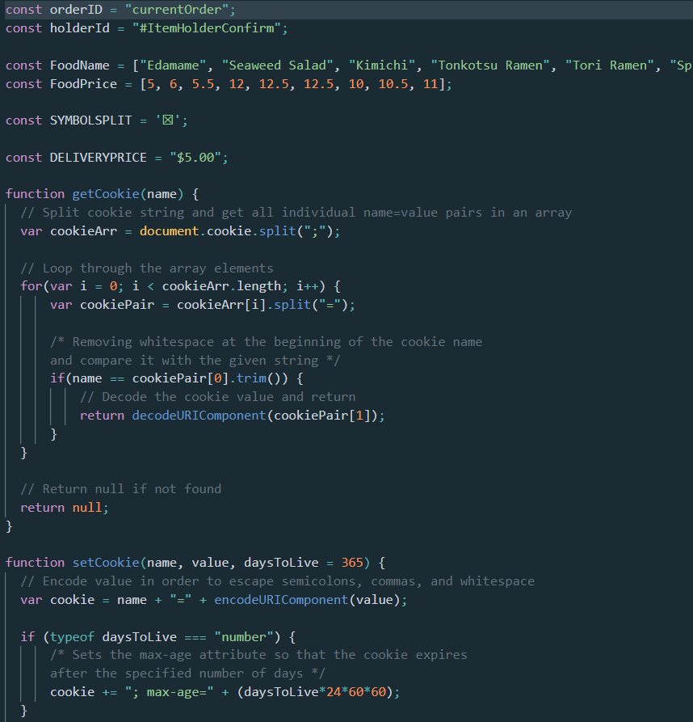
Development Process
HTML Structuring
CSS Styling
JavaScript Functionality
Code Validation
User Testing
Prototype Comparison (review)

Slide 3
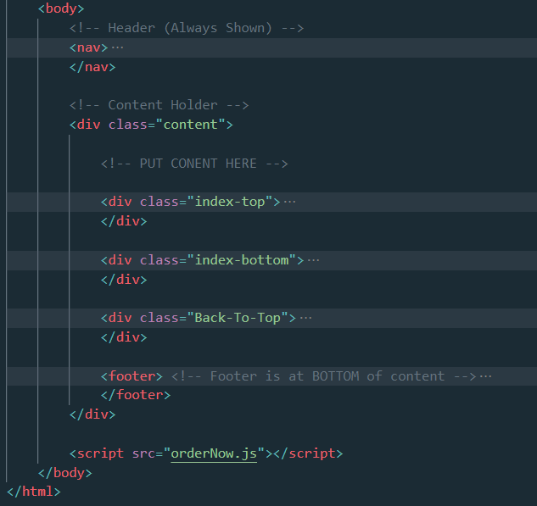
HTML Structuring
Head
Body
Nav (always shown)
Content
Footer (in bottom of content)
Scripts

Slide 4
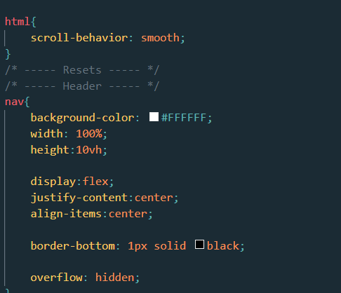
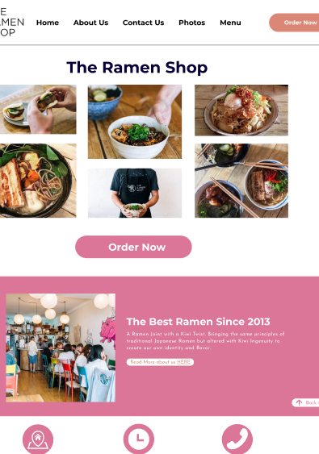
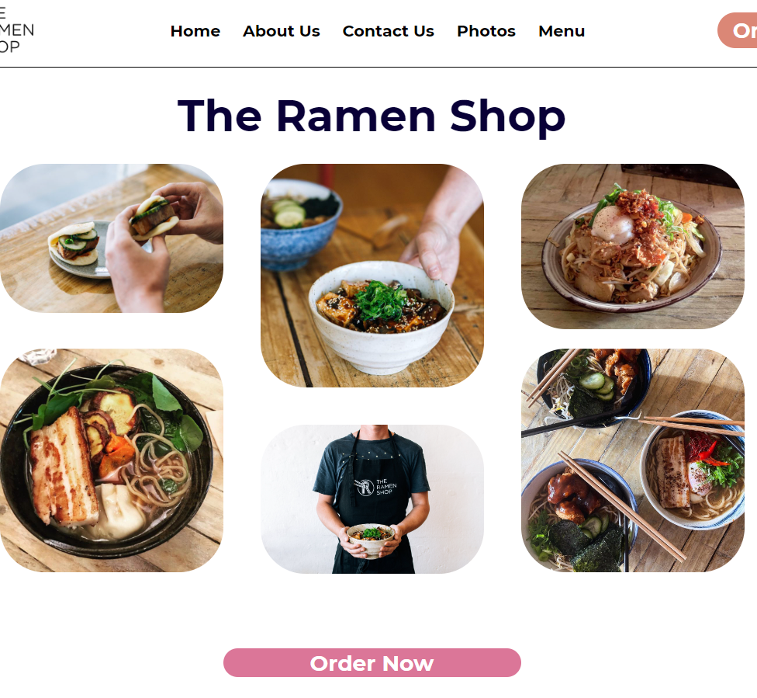
CSS Styling
Main.css
PageSpecific.css
Style Guide
Prototype
Responsive Design

Slide 5
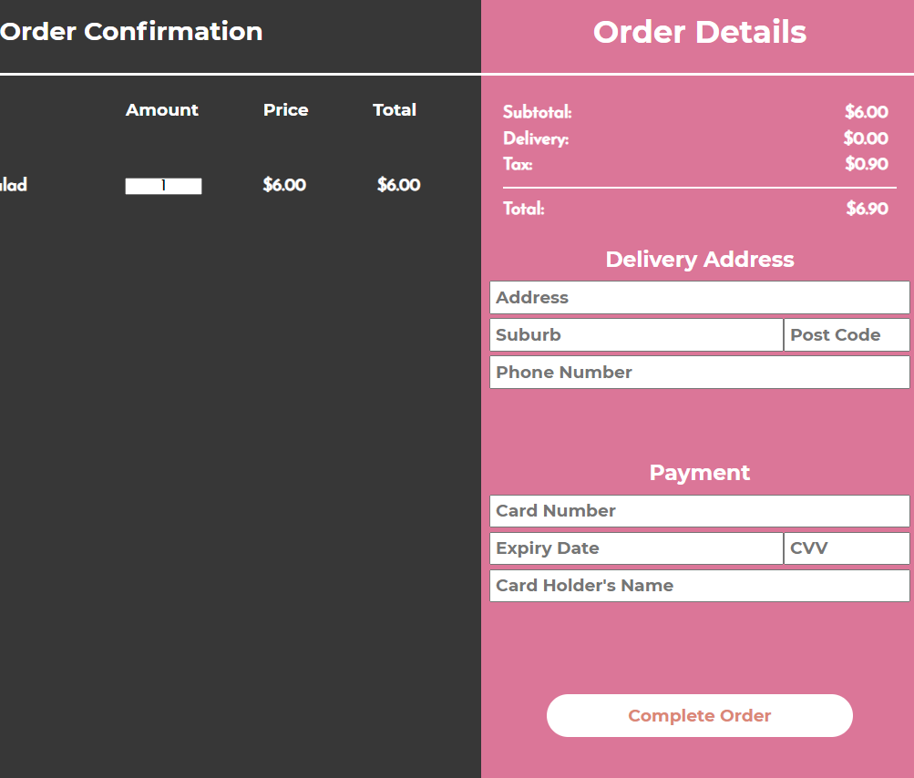
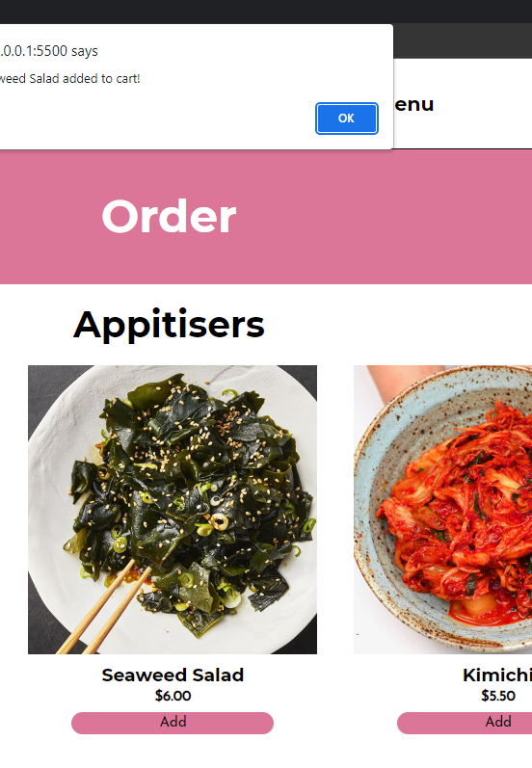
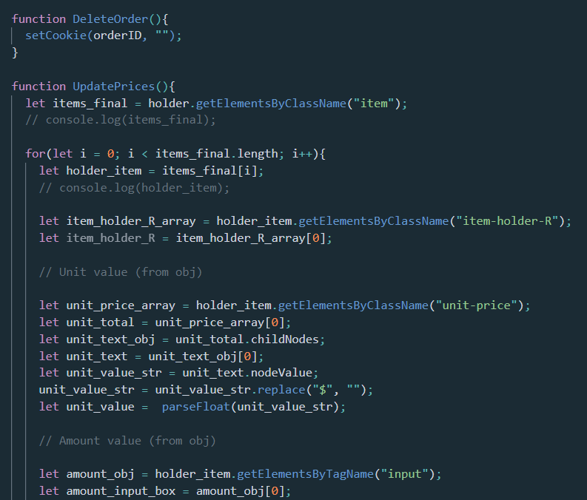
JavaScript Functionality
3 Scripts
Signinup.js
orderNow.js
Ordering.js
Cookies
How it works?

Slide 6
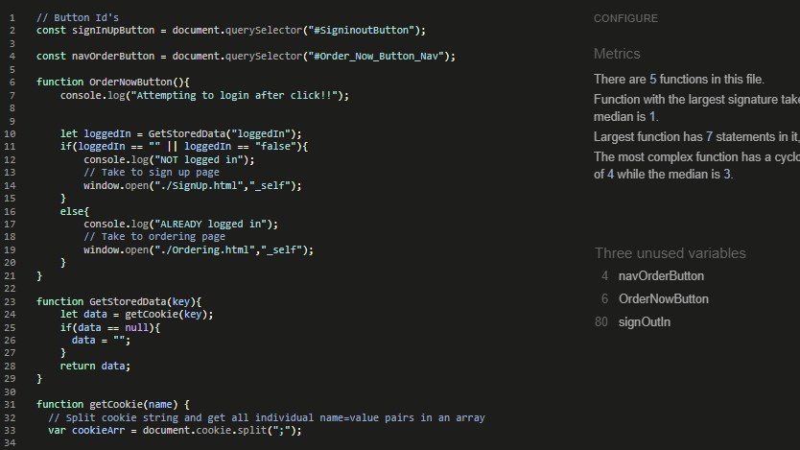
Validation

Slide 7
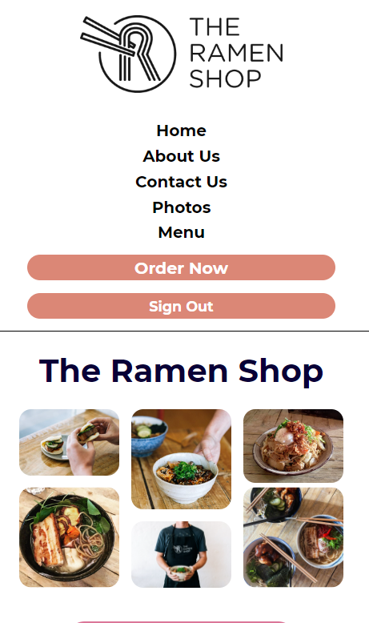
User Testing
5 Testers
Notes:
Tester 1: “I love the look of the new website, it feels welcoming and not overwhelming. Everything is exactly where I would expect to find it!”
Tester 2: “I found the sign up / login process really easy and the ordering process even easier! This is a much better improvement from the old website.”
Tester 3: “The reponsiveness of the website is really good, it worked on any device I was able to try it on and the mobile / tablet layouts look great just like the desktop layout.”
Tester 4: “I like how you kept the same colour pallete, style etc. It makes the website feel familiar to us customers who have used the old website, but is different in all good ways.”
Tester 5: “The layout is clean and exceptionaly simple. Anyone should be able to use this website with ease, it was impossible to get lost around the website. A difference I noticed was the back button in the confirm order page. That one button is a time saver for sure!”

Slide 8
Prototype vs Website
https://www.figma.com/file/i0YFLZHDfuQQHCc5uPtNqL/Figma-Work-(Group)?node-id=0%3A1
https://ilexl.github.io/ramenshop-rework/

Slide 9
The End (:

